Slide 1


AI-Driven Classification and Clustering of Dry Beans for
Smart Agriculture Using Machine Learning
Focus Area: Application of Artificial Intelligence (AI) for Agriculture Food Processing
Dr. M. Venkata Subbarao
Mr. P. Naga Raju
Dr. B. Murali Krishna
Mr. B. Veerendra
Shri Vishnu Engineering College for Women, Bhimavaram, Andhra Pradesh

Slide 2
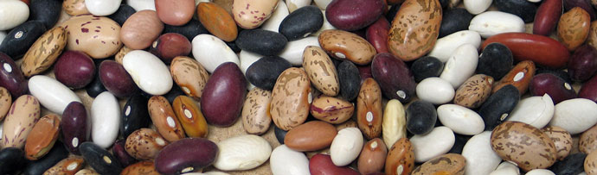
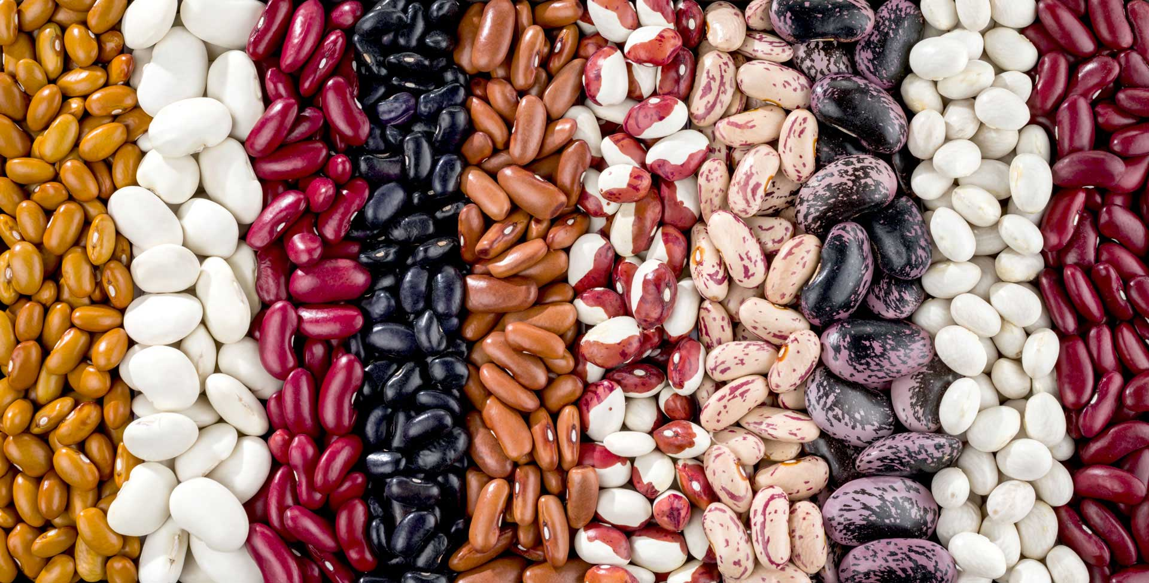
Motivation
In order to keep the economic value of Dry beans which have an important place in the agricultural economy, the efficiency of post-harvest industrial processes is very important.
To provide this efficiency, new methods and technologies are needed for the separation and classification of dry beans.
Different dry beans address different markets, which increases the need for the classification of beans.
In this study, it is aimed to develop a classification model different from traditional separation methods, based on image processing and artificial intelligence.

Slide 3
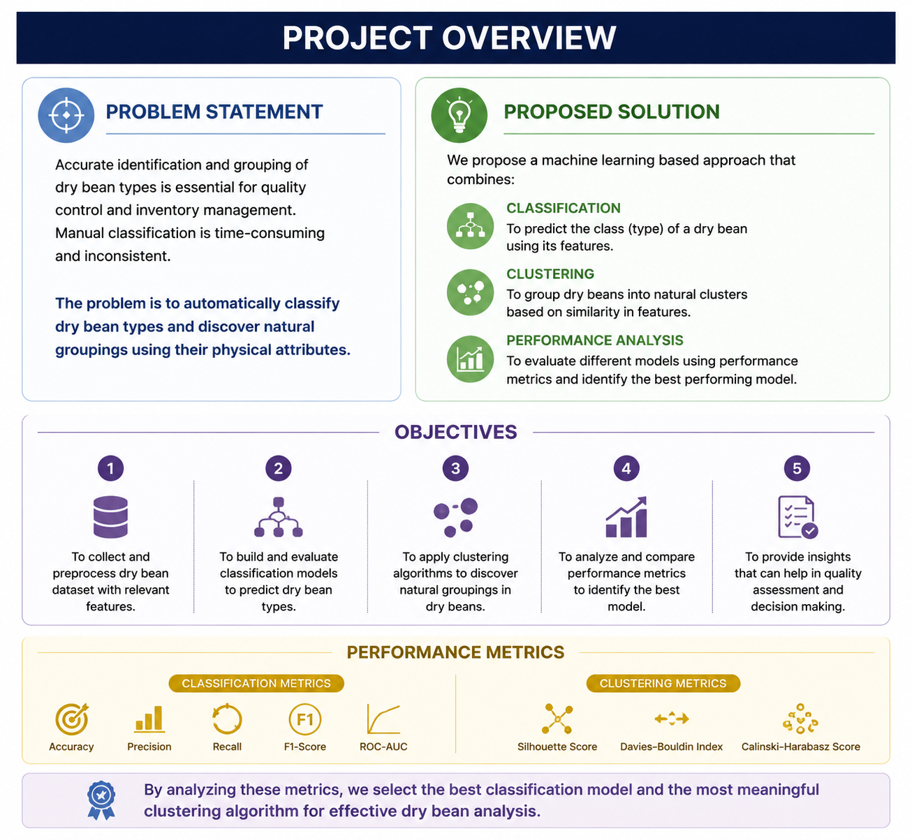

Problem Statement & Objectives

Slide 4
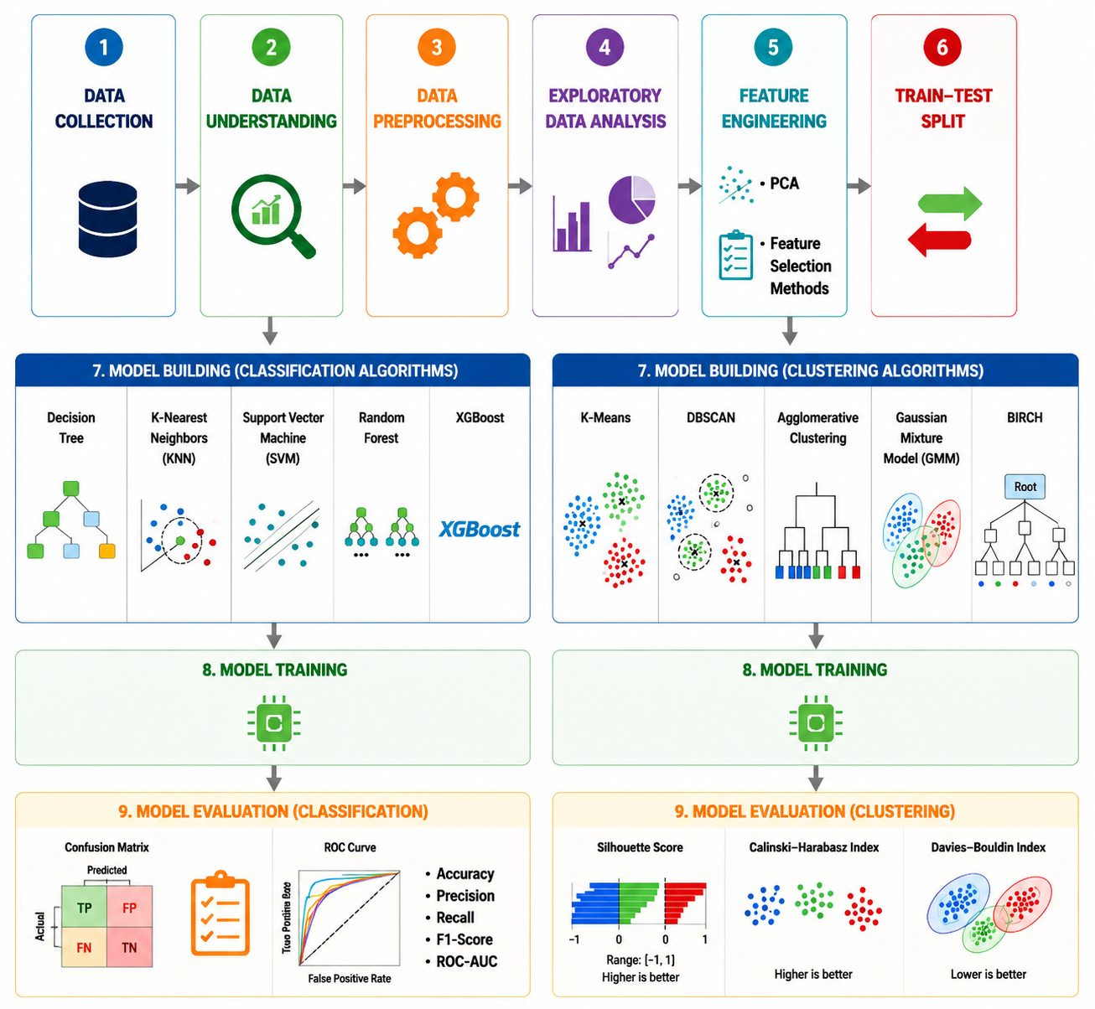
Methodology
Classification
Clustering

Slide 5
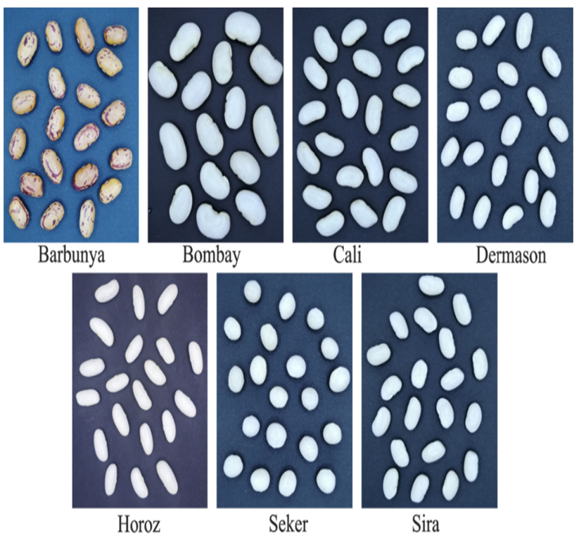
Dataset Information
S. No. | Dry Bean Class | Quantity
1 | Sira | 2636
2 | Horoz | 1928
3 | Call | 1630
4 | Dermason | 3546
5 | Bombay | 522
6 | Barbunya | 1322
7 | Seker | 2027
 | Total | 13611

Slide 6
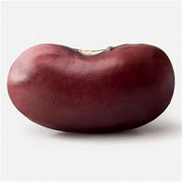
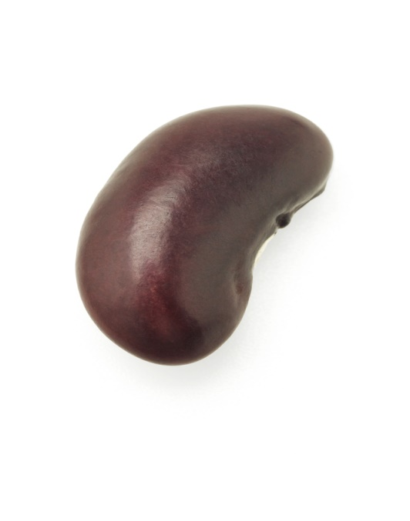
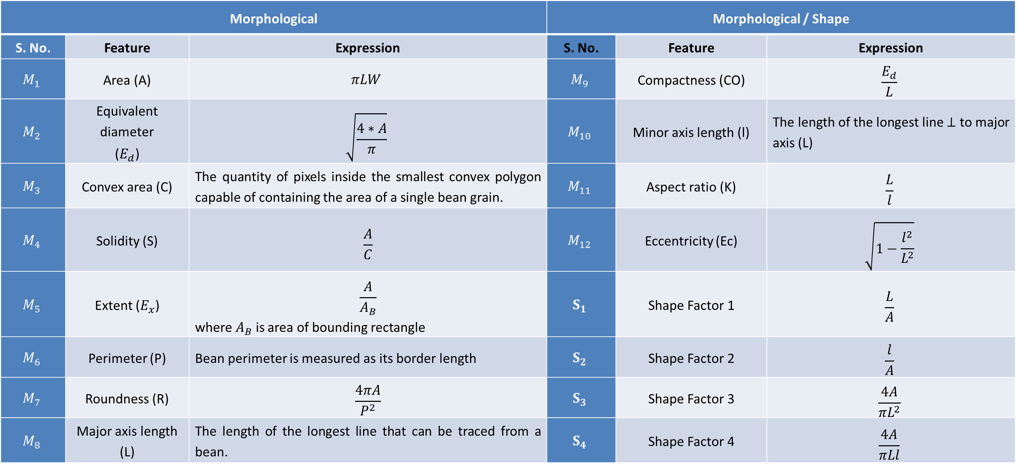
Feature Extraction
Morphological |  |  | Morphological / Shape
S. No. | Feature | Expression | S. No. | Feature | Expression
$$M_{1}$$ | Area (A) | $$πLW$$ | $$M_{9}$$ | Compactness (CO) | $$\frac{E_{d}}{L}$$
$$M_{2}$$ | Equivalent diameter ($E_{d}$) | $$\sqrt{\frac{4∗A}{π}}$$ | $$M_{10}$$ | Minor axis length (l) | The length of the longest line $⊥$ to major axis (L)
$$M_{3}$$ | Convex area (C) | The quantity of pixels inside the smallest convex polygon capable of containing the area of a single bean grain. | $$M_{11}$$ | Aspect ratio (K) | $$\frac{L}{l}$$
$$M_{4}$$ | Solidity (S) | $$\frac{A}{C}$$ | $$M_{12}$$ | Eccentricity (Ec) | $$\sqrt{1−\frac{l^{2}}{L^{2}}}$$
$$M_{5}$$ | Extent ($E_{x}$) | $$\frac{A}{A_{B}}$$ where $A_{B}$ is area of bounding rectangle | $$S_{1}$$ | Shape Factor 1 | $$\frac{L}{A}$$
$$M_{6}$$ | Perimeter (P) | Bean perimeter is measured as its border length | $$S_{2}$$ | Shape Factor 2 | $$\frac{l}{A}$$
$$M_{7}$$ | Roundness (R) | $$\frac{4πA}{P^{2}}$$ | $$S_{3}$$ | Shape Factor 3 | $$\frac{4A}{πL^{2}}$$
$$M_{8}$$ | Major axis length (L) | The length of the longest line that can be traced from a bean. | $$S_{4}$$ | Shape Factor 4 | $$\frac{4A}{πLl}$$

Slide 7
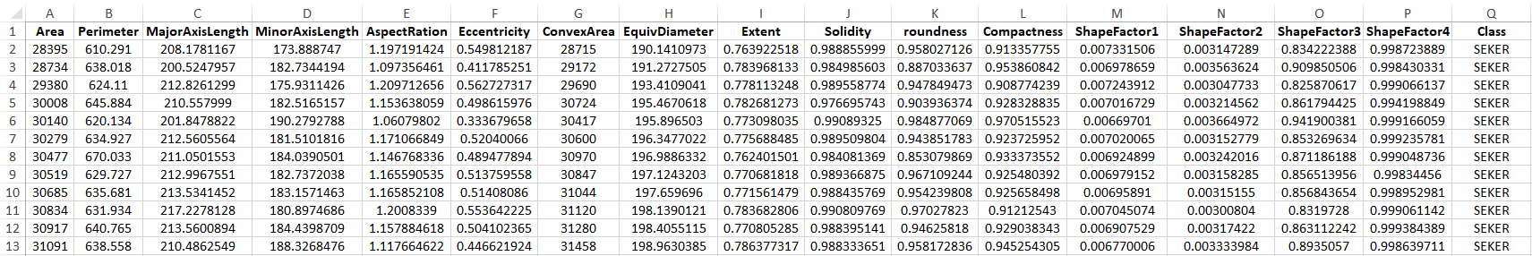
Feature Extraction

Slide 8
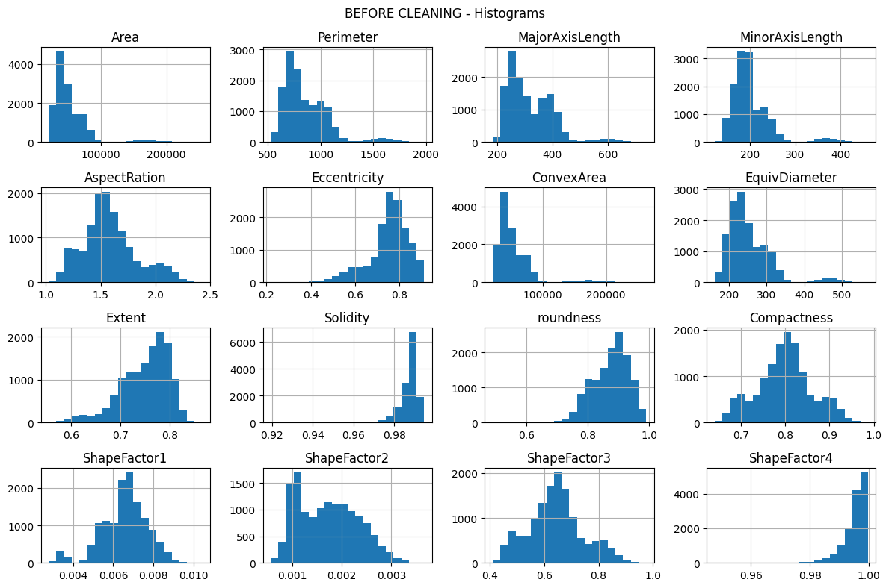
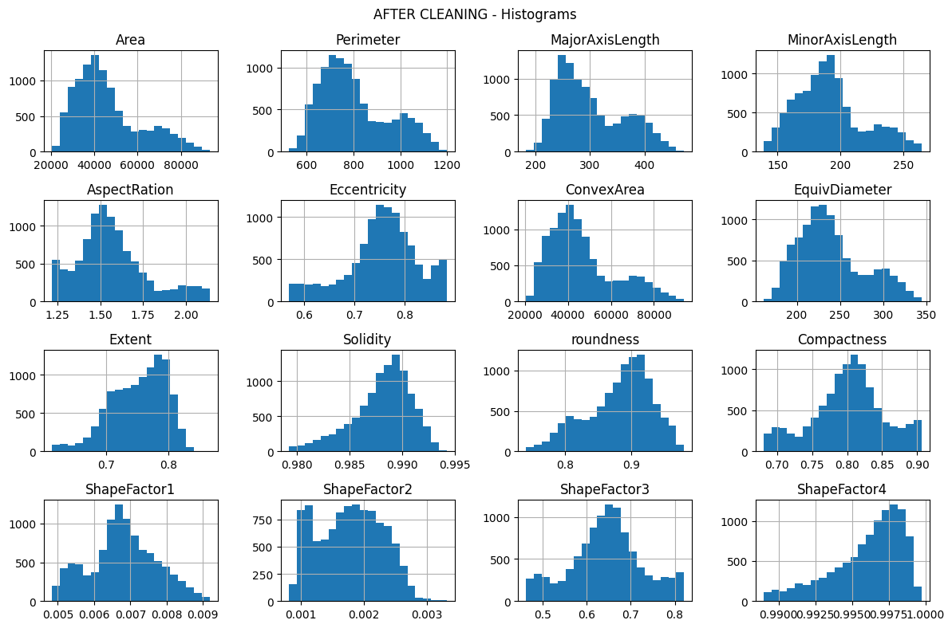
EDA - Histograms

Slide 9
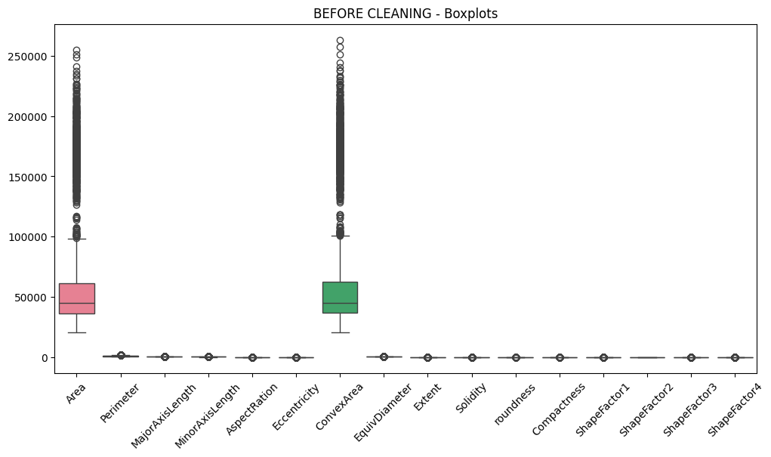
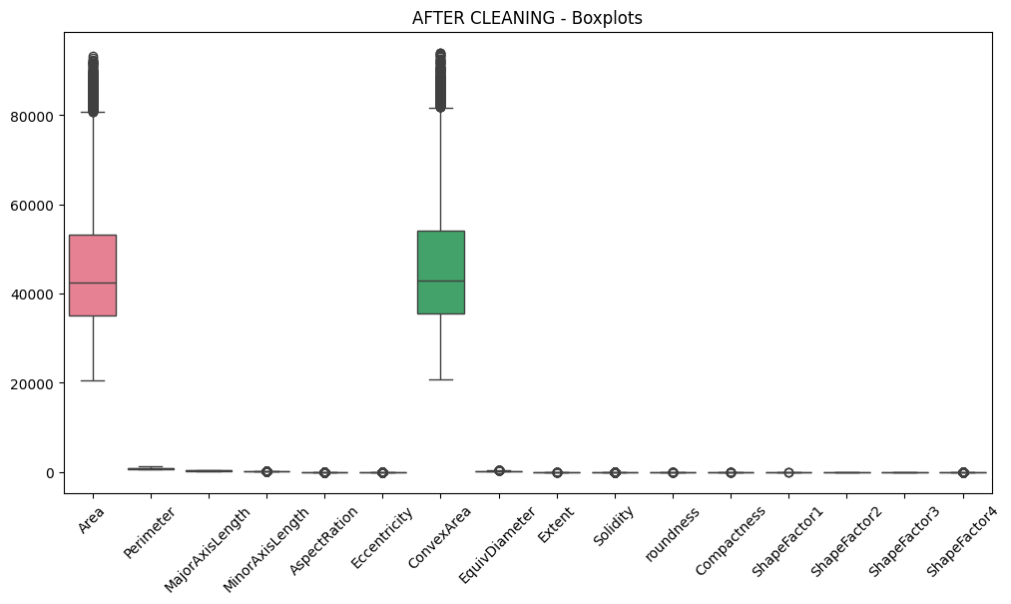
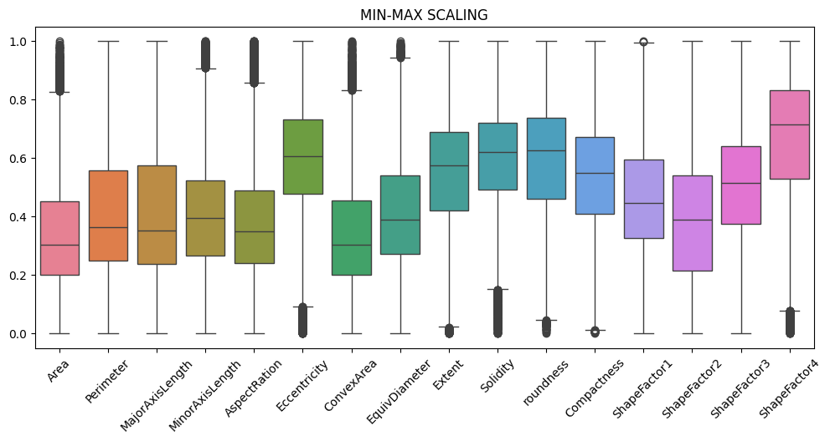
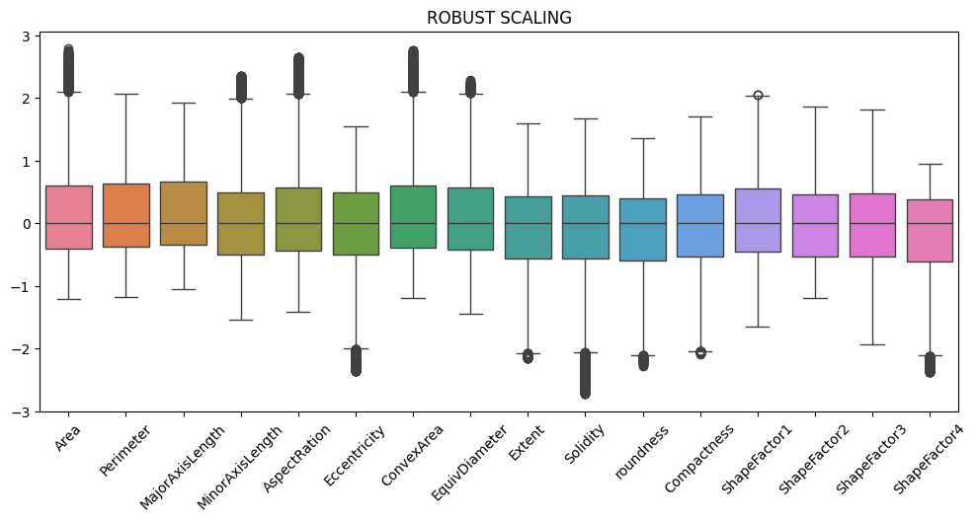
EDA- BoxPlots

Slide 10
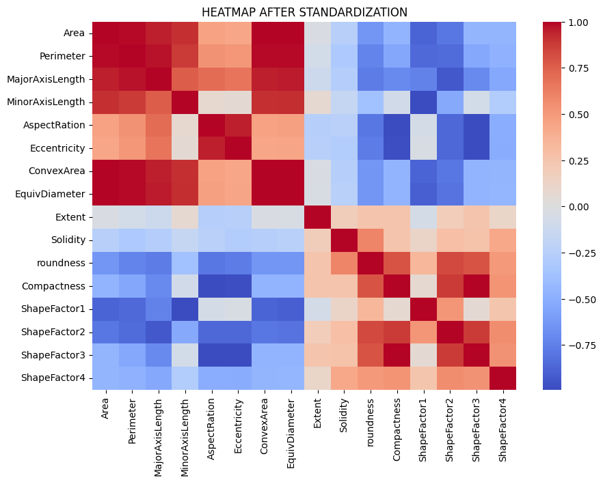
EDA - HeatMap

Slide 11
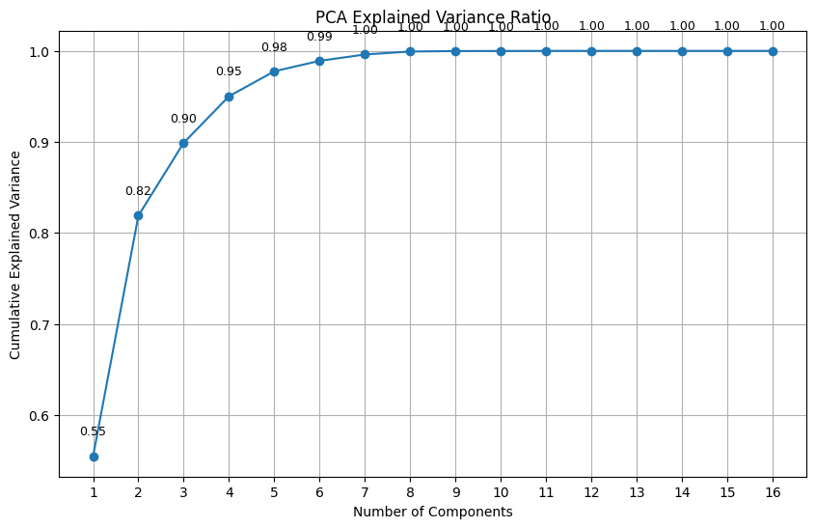

Feature Engineering – PCA, Feature Selection Algorithms
Rank | MRMR |  | ReliefF
 | Feature | MRMR score | Feature | ReliefF score
1 | MajorAxisLength | 0.9512 | ShapeFactor1 | 0.1057
2 | Extent | 0.8748 | ShapeFactor2 | 0.0904
3 | Solidity | 0.8334 | Perimeter | 0.0885
4 | ShapeFactor1 | 0.8282 | EquivDiameter | 0.0884
5 | AspectRation | 0.8065 | MinorAxisLength | 0.0874
6 | ShapeFactor4 | 0.8065 | MajorAxisLength | 0.0865
7 | roundness | 0.7869 | Area | 0.0698
8 | ShapeFactor2 | 0.7532 | ConvexArea | 0.0685
9 | EquivDiameter | 0.7173 | Compactness | 0.0607
10 | MinorAxisLength | 0.7173 | ShapeFactor3 | 0.0598
11 | Perimeter | 0.6455 | AspectRation | 0.0588
12 | ShapeFactor3 | 0.6286 | Extent | 0.0544
13 | ConvexArea | 0.6286 | roundness | 0.0471
14 | Compactness | 0.5782 | Eccentricity | 0.0455
15 | Area | 0.5744 | ShapeFactor4 | 0.0258
16 | Eccentricity | 0.5495 | Solidity | 0.0198

Slide 12
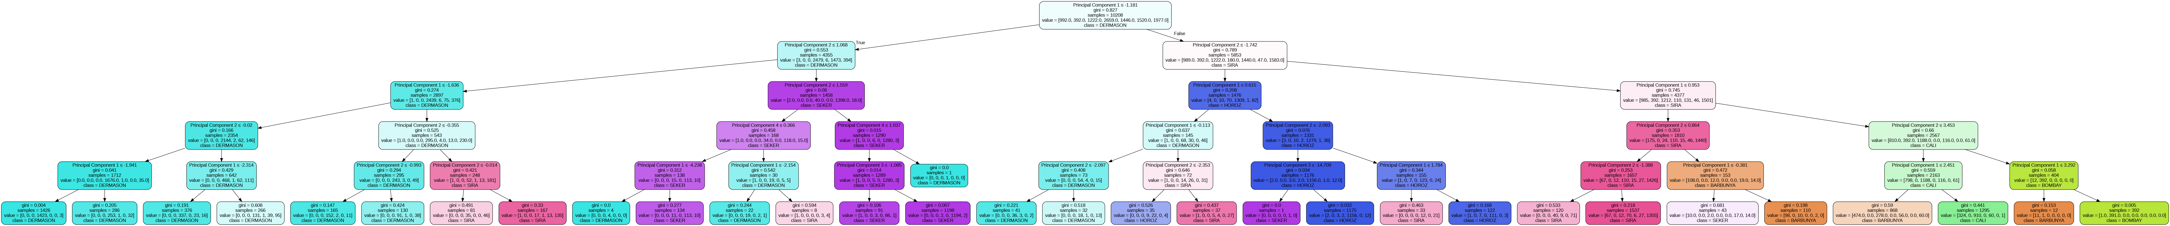
Classification using Decision Tree

Slide 13
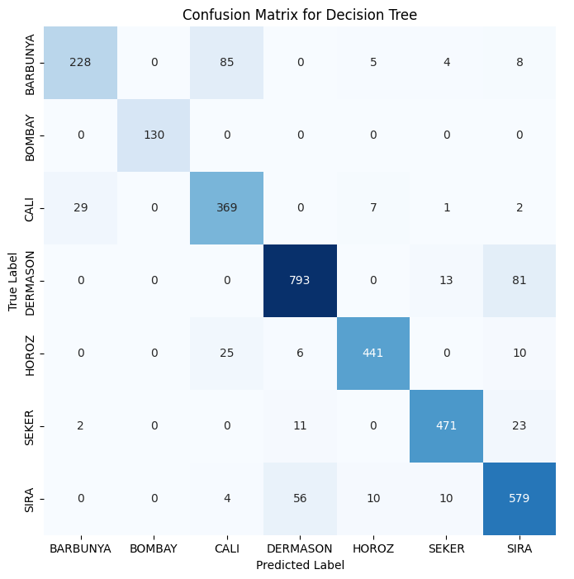
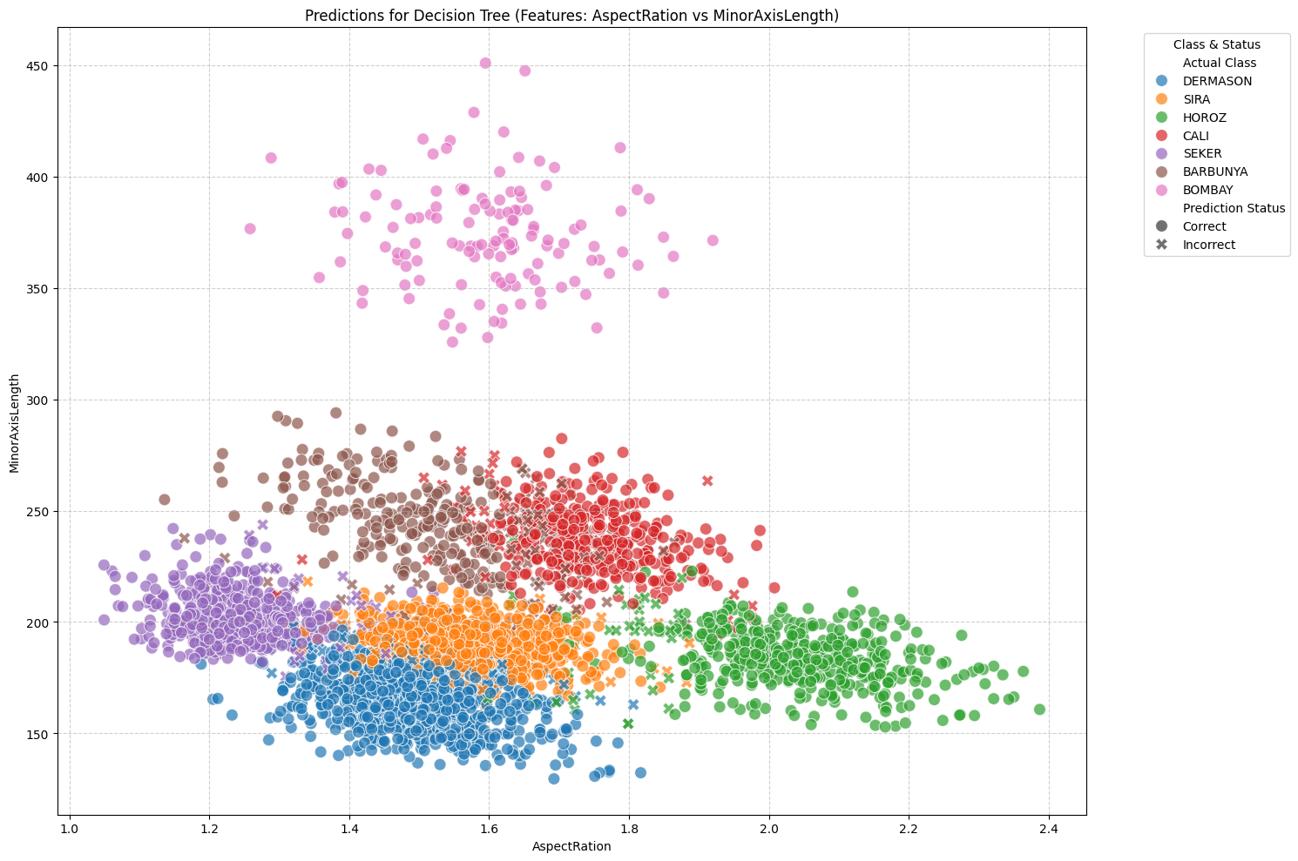
Classification using DT

Slide 14
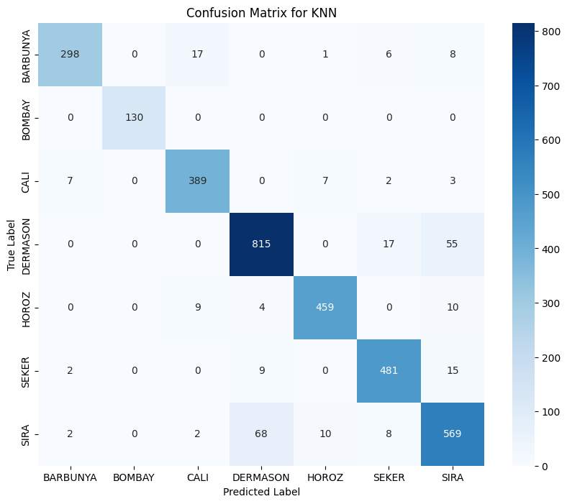

Classification using DT
Accuracy (%) | Weighted Precision | Weighted Recall | Weighted F1-Score | AUC
88.481 | 0.889 | 0.885 | 0.885 | 0.978
Accuracy (%) | Weighted Precision | Weighted Recall | Weighted F1-Score | AUC
85.01 | 0.852 | 0.850 | 0.850 | 0.973

Slide 15
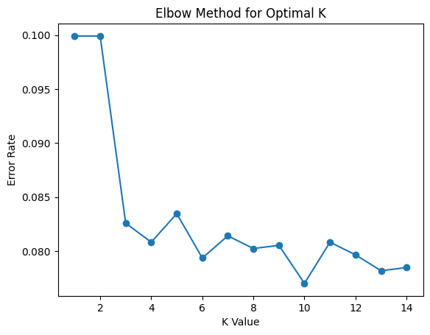
Classification using KNN
Accuracy (%) | Weighted Precision | Weighted Recall | Weighted F1-Score | AUC
92.30 | 0.923 | 0.923 | 0.923 | 0.988
Accuracy (%) | Weighted Precision | Weighted Recall | Weighted F1-Score | AUC
89.53 | 0.895 | 0.895 | 0.894 | 0.982

Slide 16
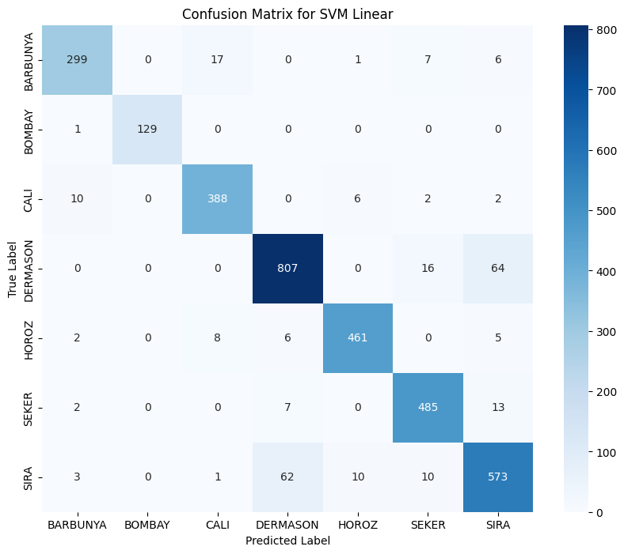

Classification using SVM
Accuracy (%) | Weighted Precision | Weighted Recall | Weighted F1-Score | AUC
92.33 | 0.923 | 0.922 | 0.923 | 0.995
Accuracy (%) | Weighted Precision | Weighted Recall | Weighted F1-Score | AUC
92.54 | 0.926 | 0.925 | 0.926 | 0.994

Slide 17
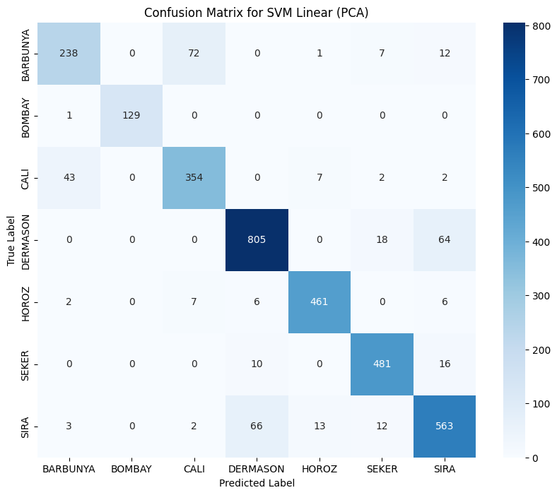

Classification using SVM
Accuracy (%) | Weighted Precision | Weighted Recall | Weighted F1-Score | AUC
89.06 | 0.890 | 0.891 | 0.890 | 0.990
Accuracy (%) | Weighted Precision | Weighted Recall | Weighted F1-Score | AUC
90.04 | 0.901 | 0.900 | 0.899 | 0.9912

Slide 18
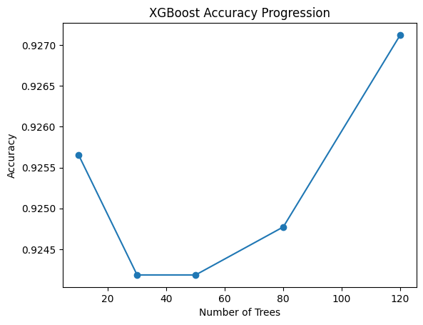

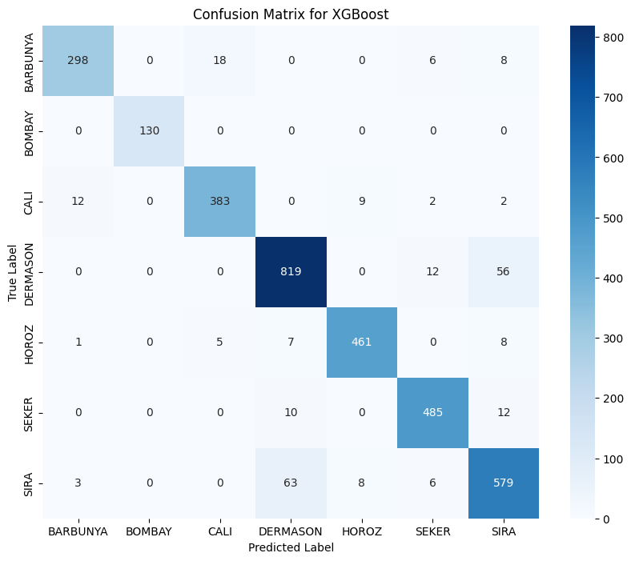
Classification using Ensemble Methods
Accuracy (%) | Weighted Precision | Weighted Recall | Weighted F1-Score | AUC
91.86 | 0.919 | 0.918 | 0.918 | 0.9913
Accuracy (%) | Weighted Precision | Weighted Recall | Weighted F1-Score | AUC
92.71 | 0.9274 | 0.9271 | 0.9271 | 0.9950

Slide 19
Performance Comparison
Without PCA
With PCA
Model | Accuracy | Weighted Precision | Weighted Recall | Weighted F1-Score | AUC
DT | 0.884808 | 0.888875 | 0.884808 | 0.884758 | 0.978576
KNN | 0.923009 | 0.923323 | 0.923009 | 0.923038 | 0.988480
SVM Linear | 0.923303 | 0.923447 | 0.923303 | 0.923304 | 0.995244
SVM RBF | 0.925360 | 0.925882 | 0.925360 | 0.925464 | 0.994968
Random Forest | 0.918601 | 0.918718 | 0.918601 | 0.918592 | 0.991329
XGBoost | 0.927123 | 0.927410 | 0.927123 | 0.927192 | 0.995022
Model | Accuracy | Weighted Precision | Weighted Recall | Weighted F1-Score | AUC
DT | 0.850132 | 0.852259 | 0.850132 | 0.850848 | 0.973365
KNN | 0.895386 | 0.895360 | 0.895386 | 0.894979 | 0.982626
SVM Linear | 0.890685 | 0.890469 | 0.890685 | 0.890084 | 0.990942
SVM RBF | 0.900382 | 0.901044 | 0.900382 | 0.899753 | 0.991248
Random Forest | 0.897150 | 0.896822 | 0.897150 | 0.896731 | 0.988445
XGBoost | 0.887158 | 0.886938 | 0.887158 | 0.886922 | 0.989264
Observations:
PCA Achieved Significant Feature Reduction (75%) with Moderate Accuracy Loss (~2-3%)
Original Feature Space Provides Superior Classification Performance (XGBoost (92.71%))
PCA Offers a Favorable Accuracy–Complexity Tradeoff (SVM-RBF - 90.04%)

Slide 20
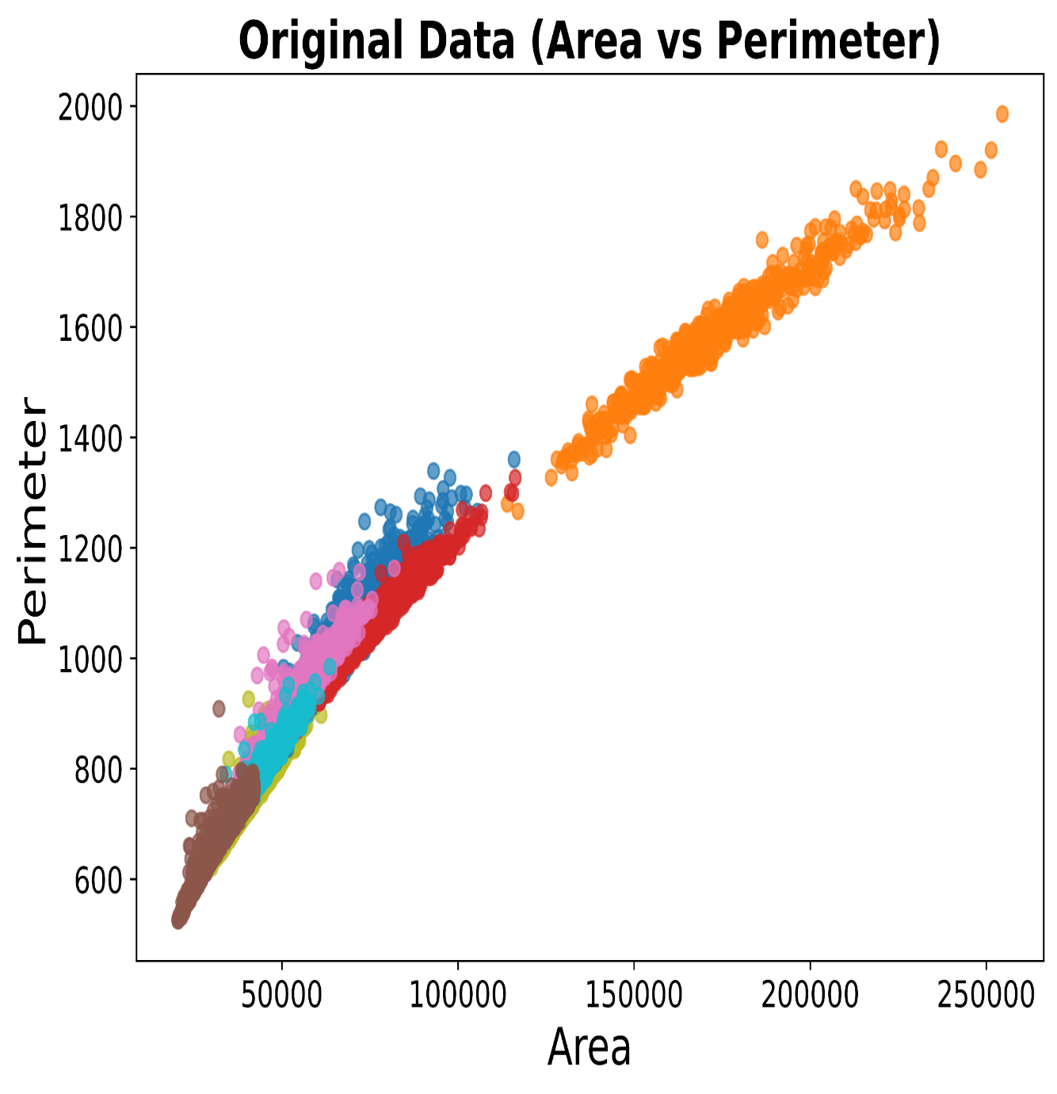
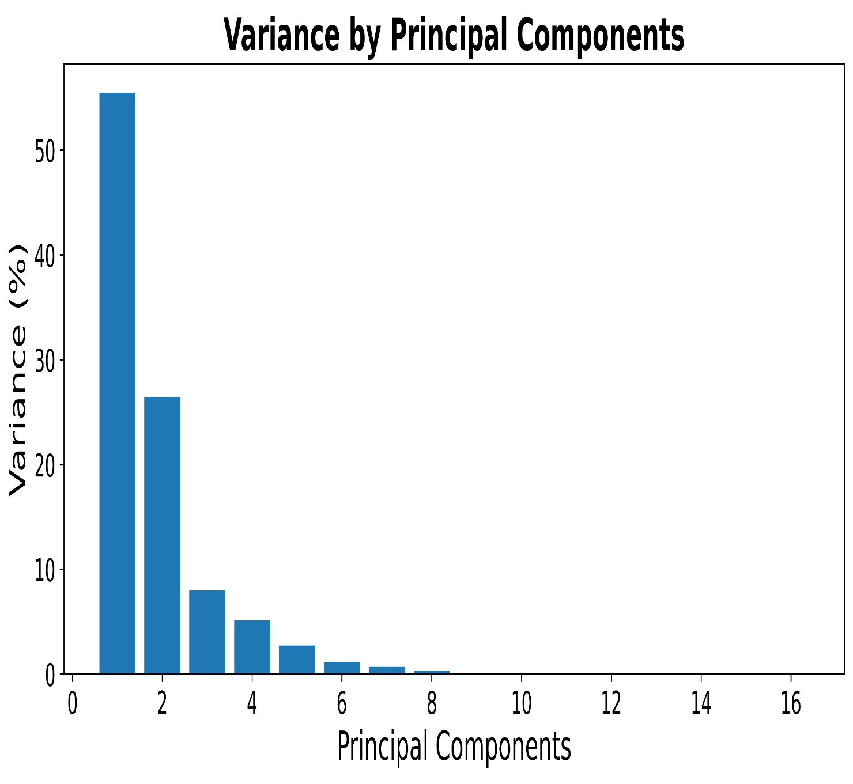
Clustering Algorithms

Slide 21
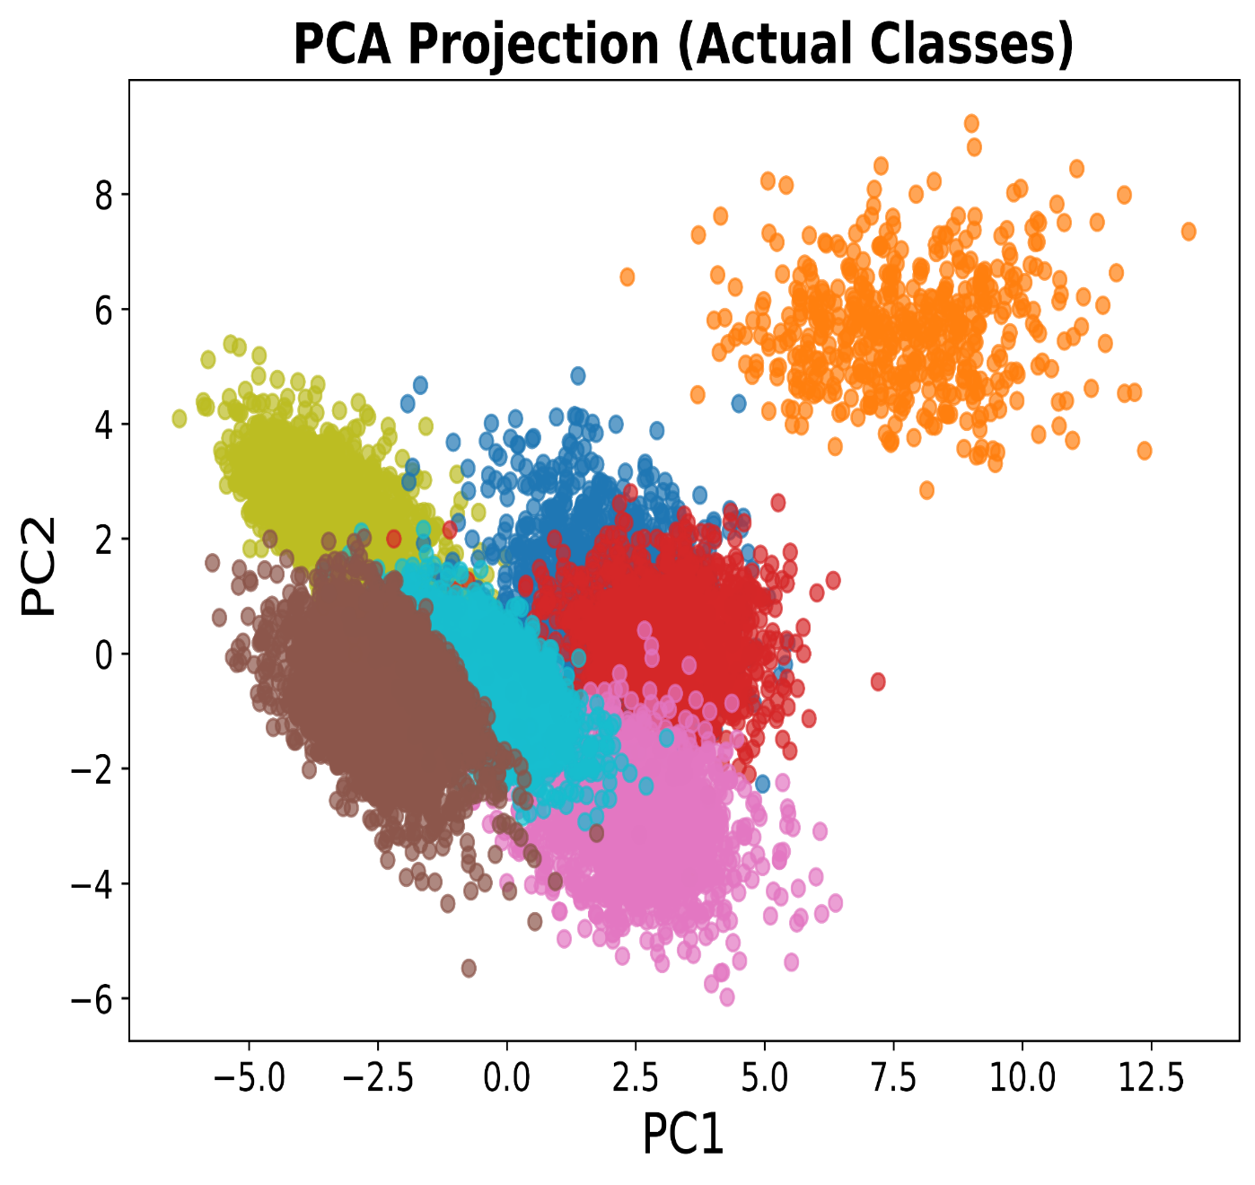
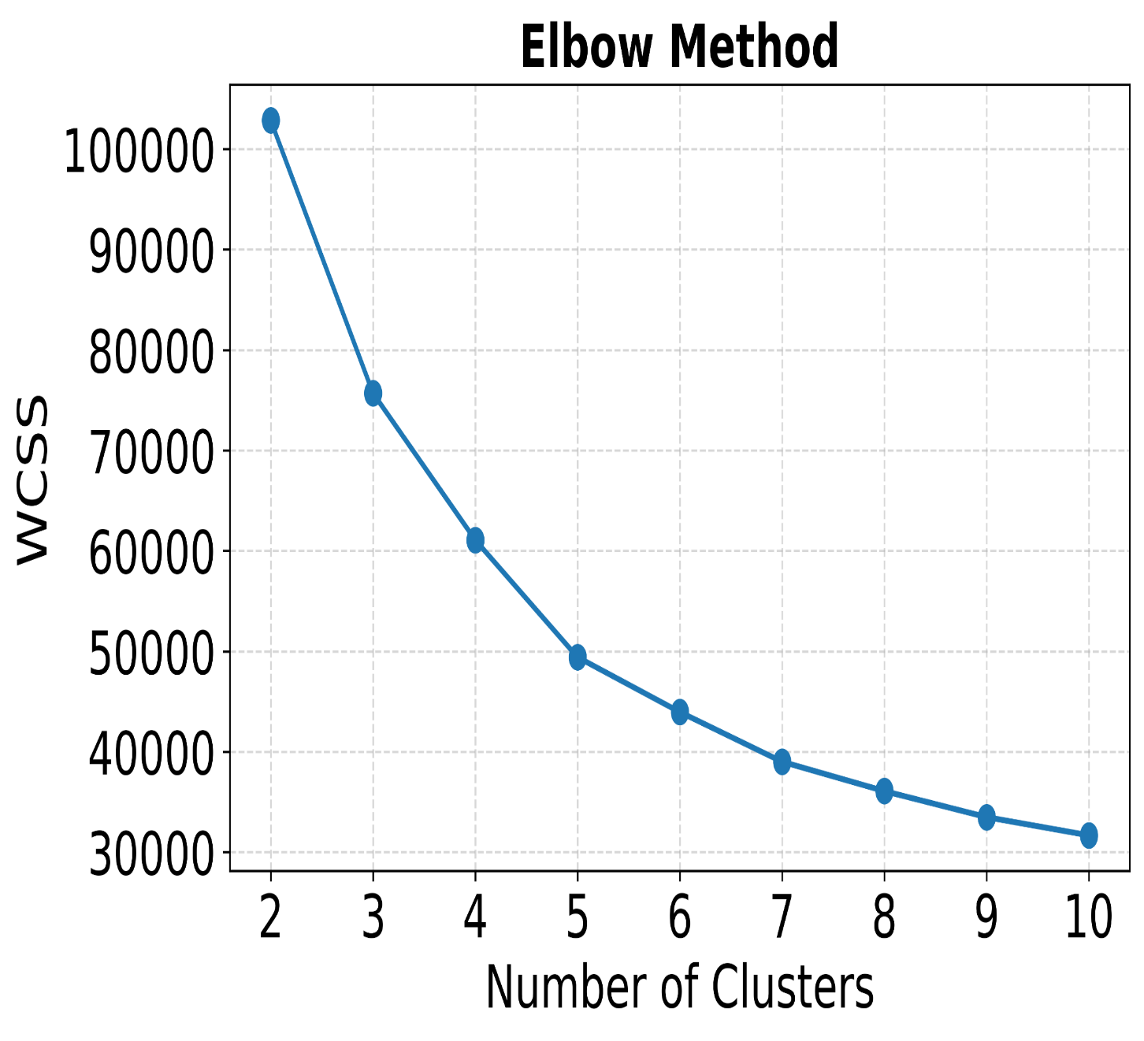
PCA and Elbow Method:

Slide 22
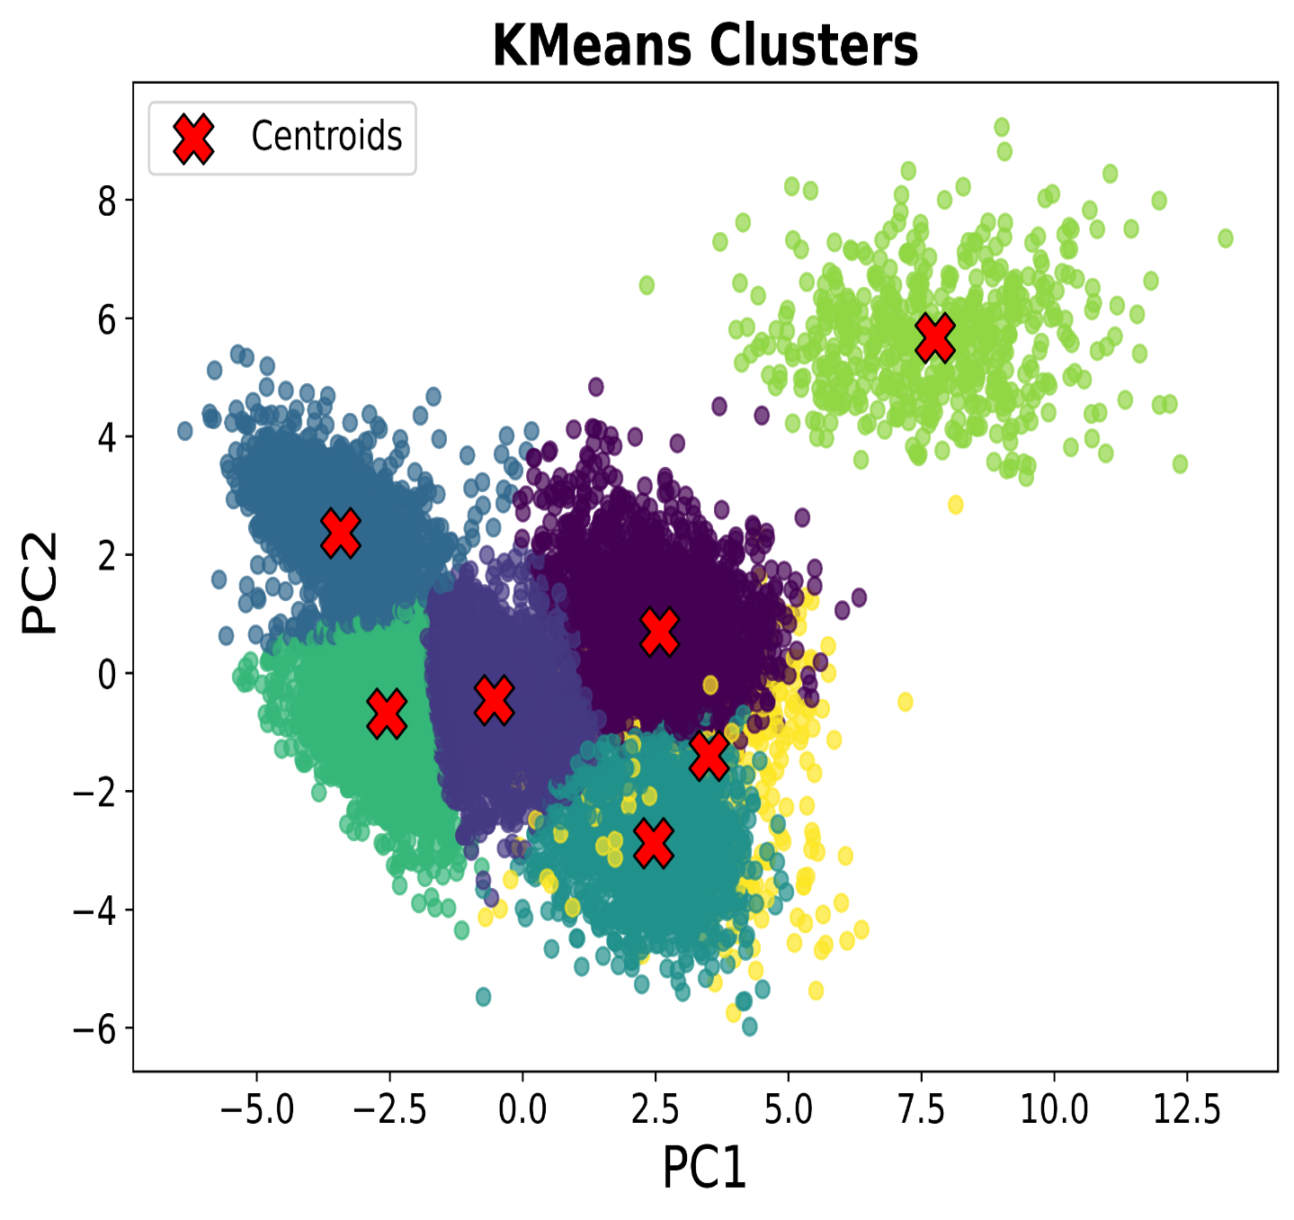
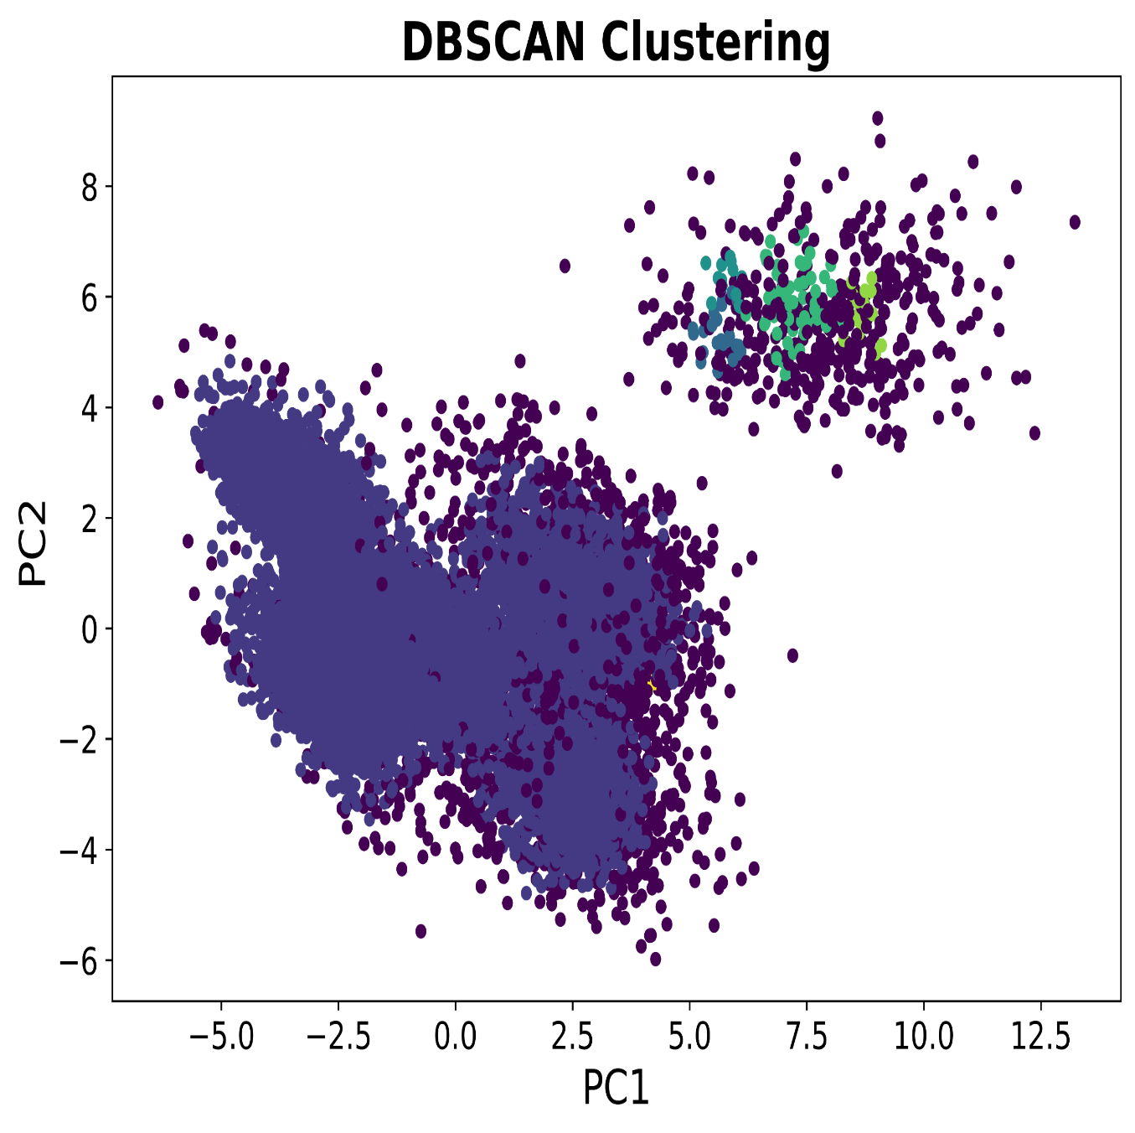
Clustering Methods:

Slide 23
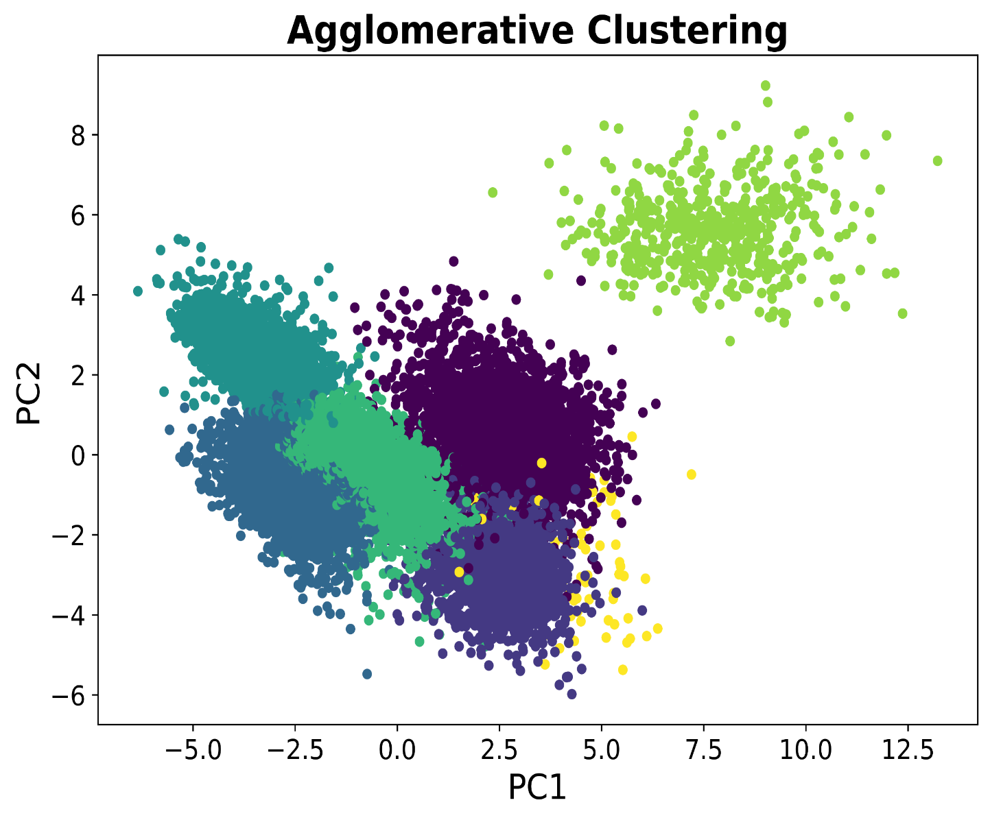
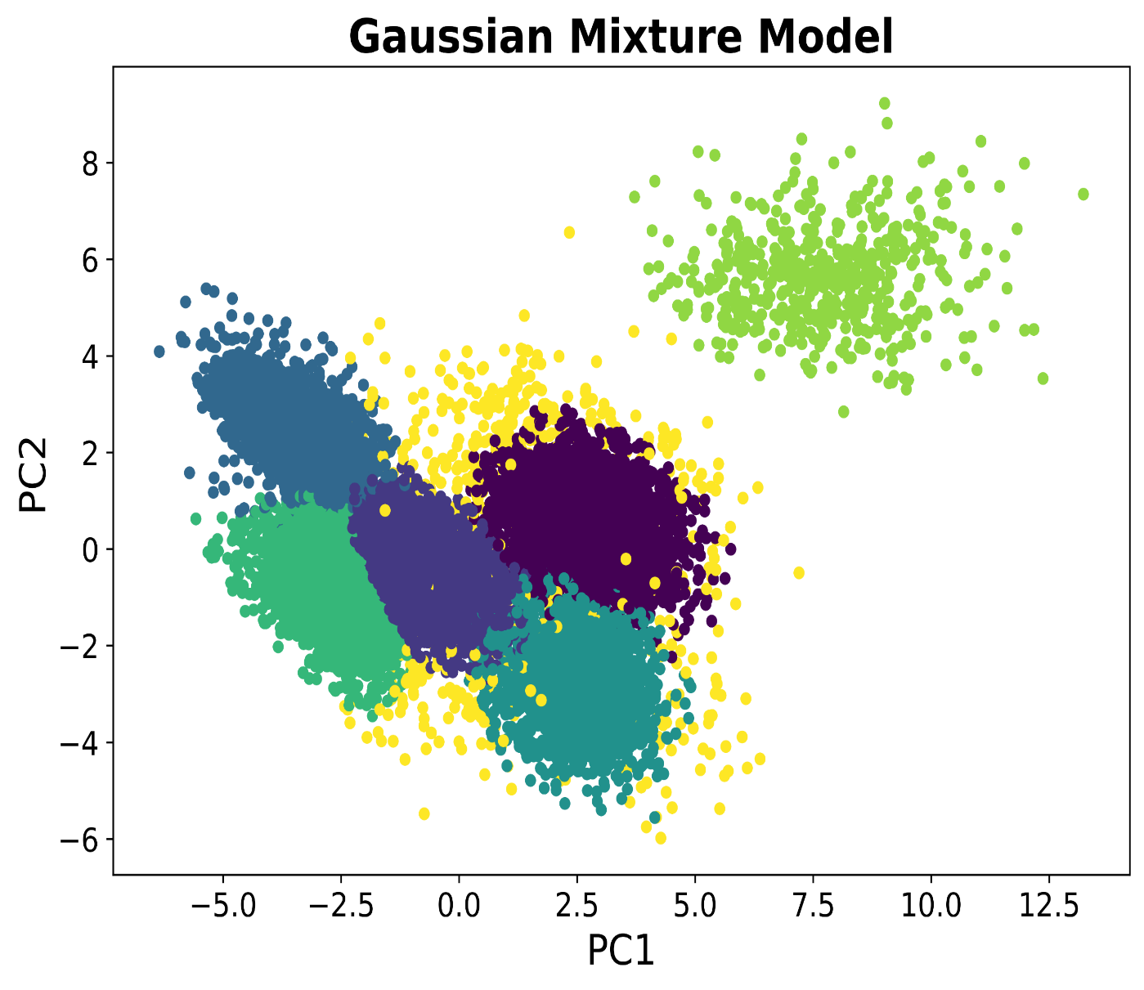
Clustering Methods:

Slide 24
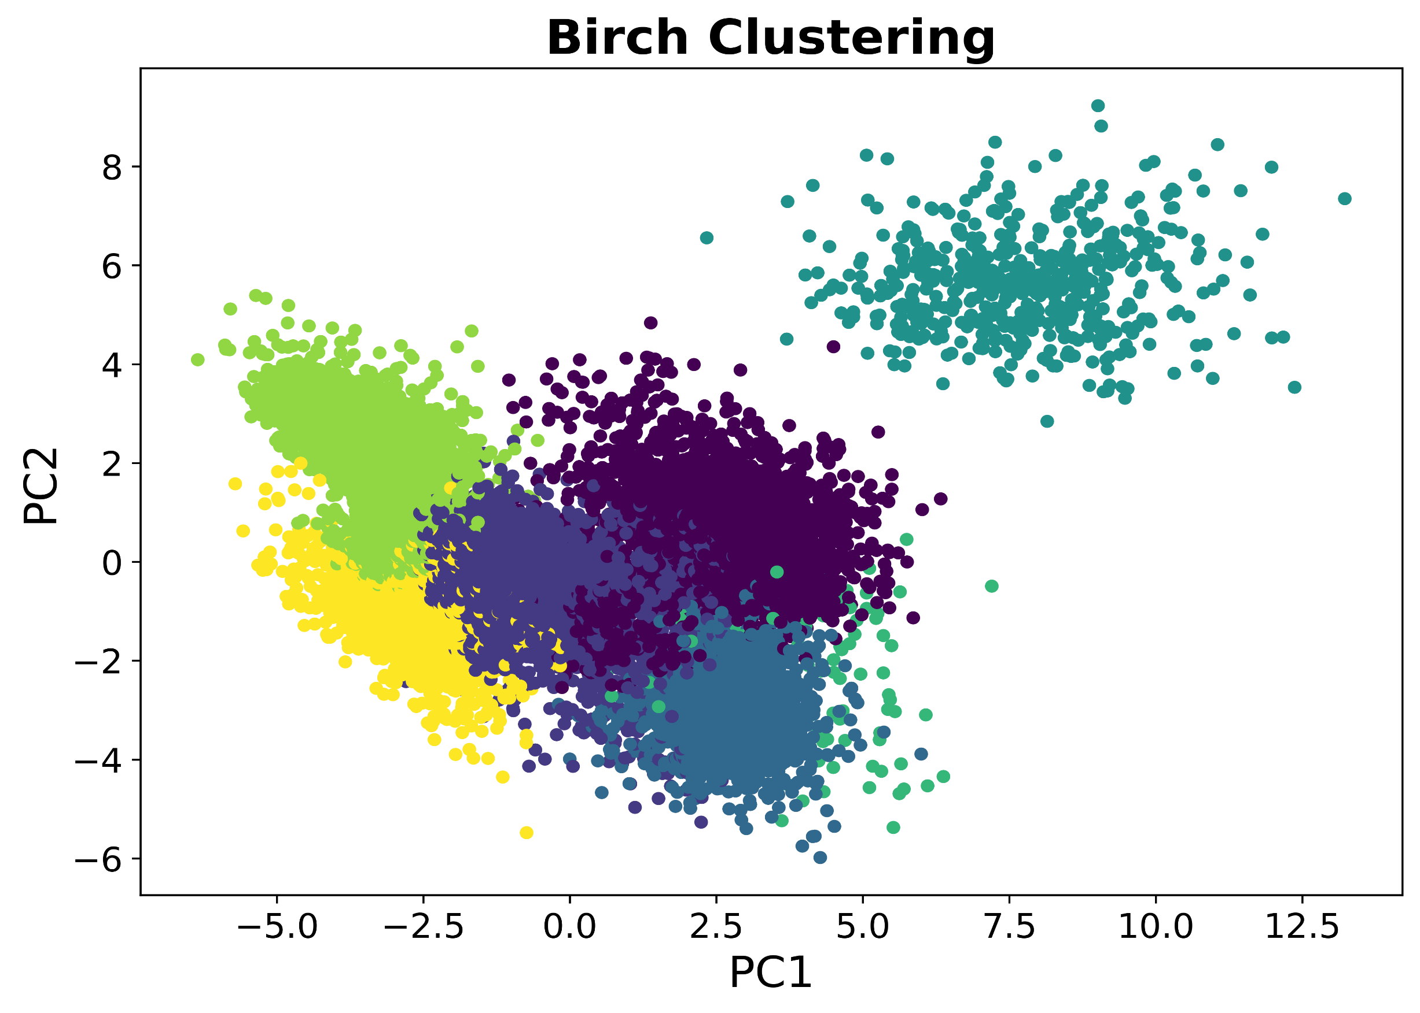
Clustering Method:

Slide 25
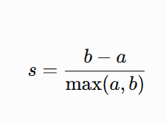
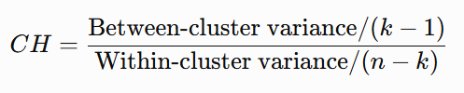
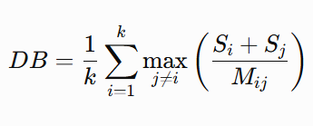
Clustering Evaluation Metrics:
Silhouette Score
Range: -1 to +1
Higher is better
Measures cluster cohesion and separation
Calinski– Harabasz Index
Range: 0 to ∞
Higher is better
Ratio of between-cluster to within-cluster variance
Davies–Bouldin Index
Range: 0 to ∞
Lower is better
Measures cluster similarity and overlap

Slide 26
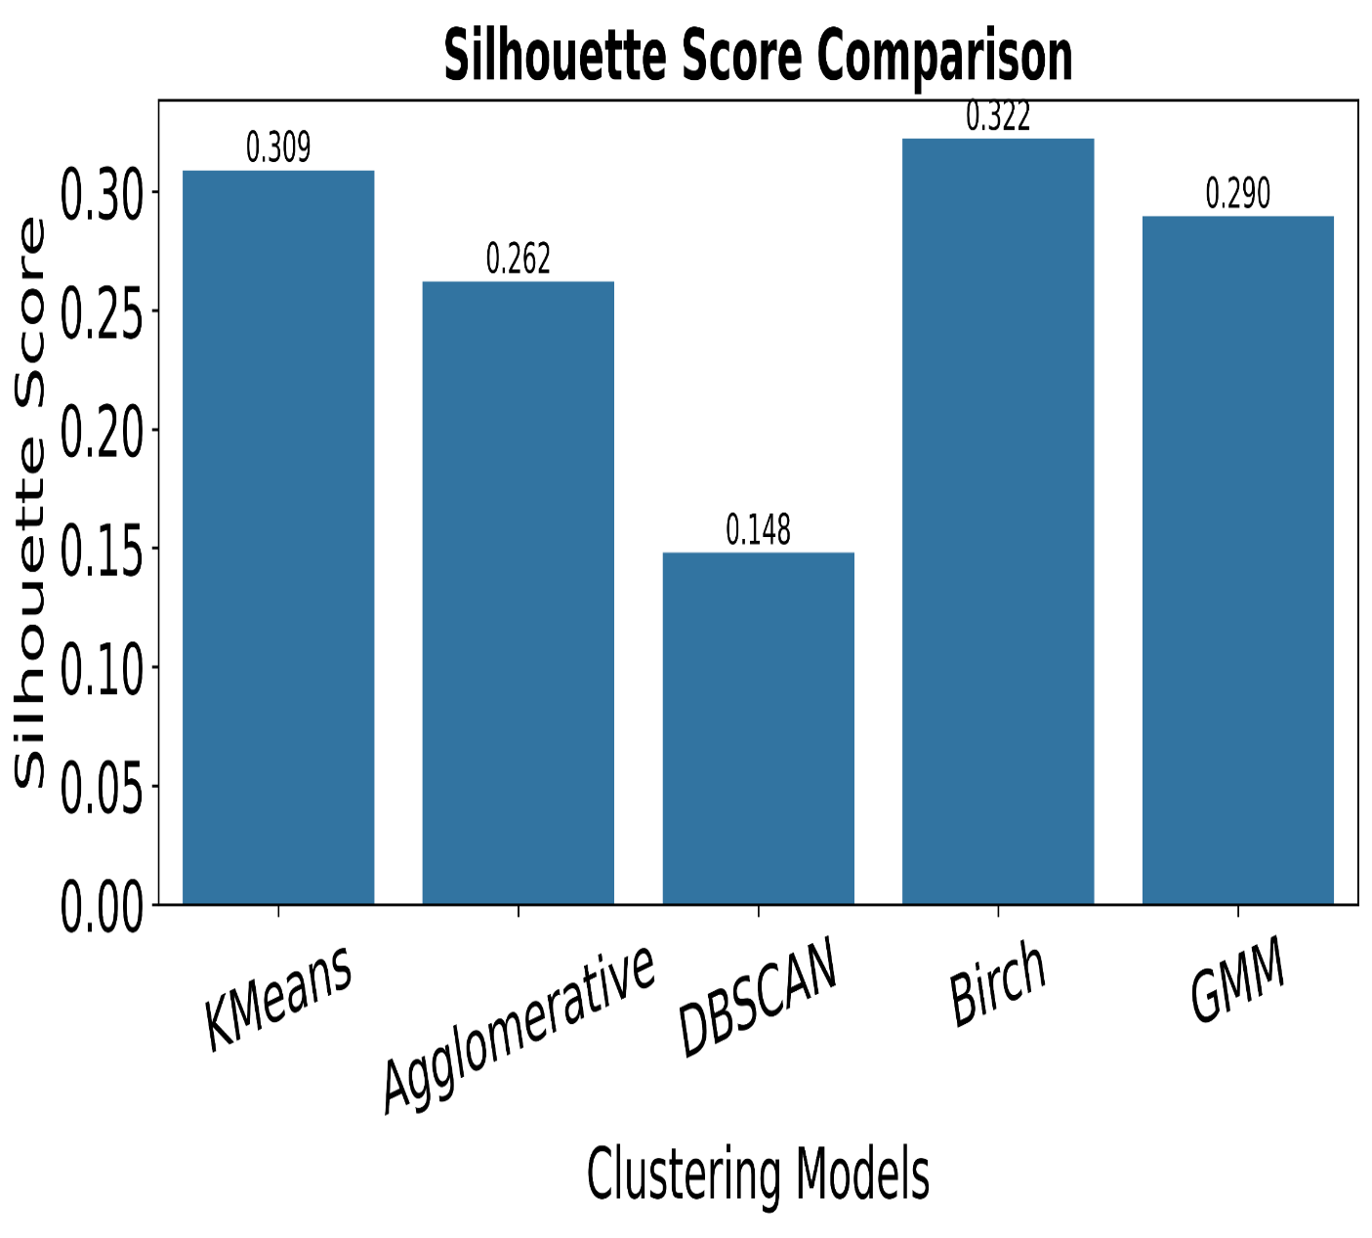
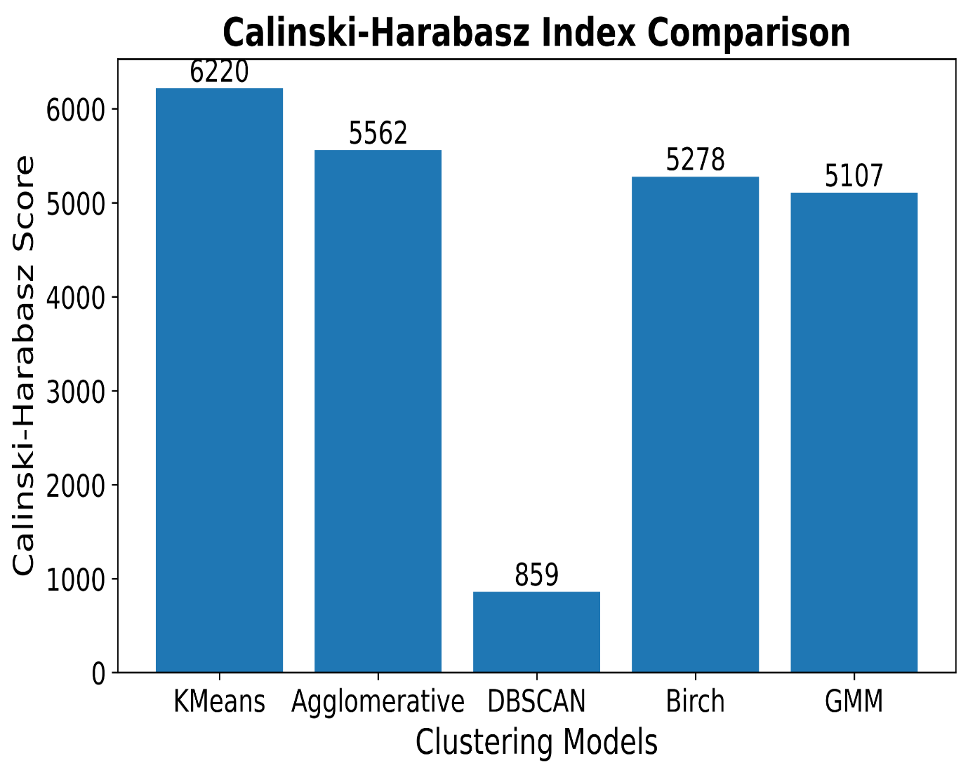
Comparative Evaluation

Slide 27
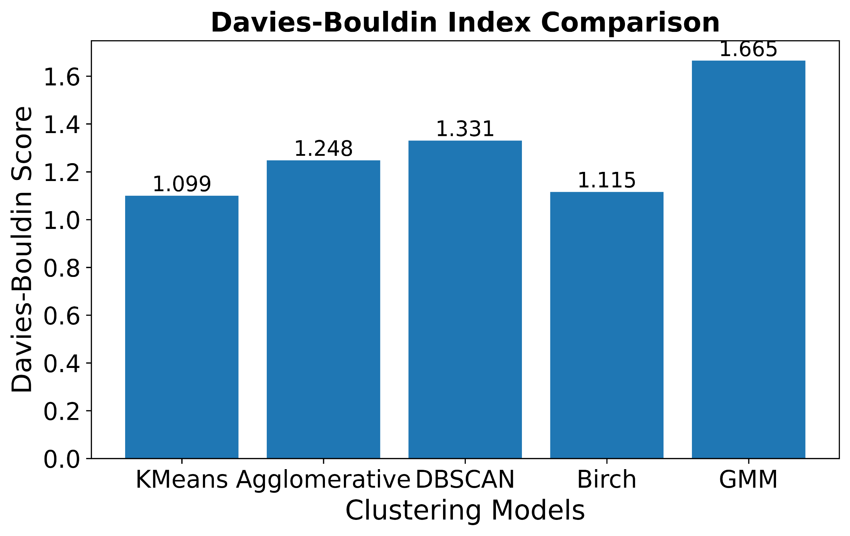
Comparative Evaluation

Slide 28
Comparative Evaluation
Model | Silhouette Score ↑ | Calinski– Harabasz Index ↑ | Davies– Bouldin Index ↓
K-Means | 0.309 | 6219.92 | 1.0994
Agglomerative | 0.2622 | 5562.25 | 1.2477
DBSCAN | 0.1481 | 858.78 | 1.3306
Birch | 0.3224 | 5277.53 | 1.1150
GMM | 0.2897 | 5107.09 | 1.6652
Observations:
PCA effectively reduced dimensionality, preserving the most significant variance and enabling clear visualization of the bean dataset.
K-Means and Birch achieved the best clustering performance, with K-Means obtaining the highest Calinski–Harabasz Index (6219.92) and lowest Davies– Bouldin Index (1.0994), while Birch achieved the highest Silhouette Score (0.3224).
The combination of PCA and clustering successfully identified natural groupings in the dataset, demonstrating its effectiveness for unsupervised pattern and data analysis.

Slide 29
References
https://www.kaggle.com/datasets/muratkokludataset/dry-bean-dataset
KOKLU, M. and OZKAN, I.A., (2023), Multiclass Classification of Dry Beans Using Computer Vision and Machine Learning Techniques. Computers and Electronics in Agriculture, 174, 105507. DOI: https://doi.org/10.1016/j.compag.2020.105507

Slide 30
Thank You

